Slide 1
Dazed & Confused:
A Legal and Biomechanical Primer on Traumatic Brain Injuries in the Wake of the NFL Controversy
Reinsurance Symposium
St. Joseph’s University
Erivan K. Haub School of Business

Slide 2


PRESENTERS
Jason C. Giurintano, Esquire
Joshua J. Bovender, Esquire
Brian M. Boggess, M.S., P.E.

Slide 3
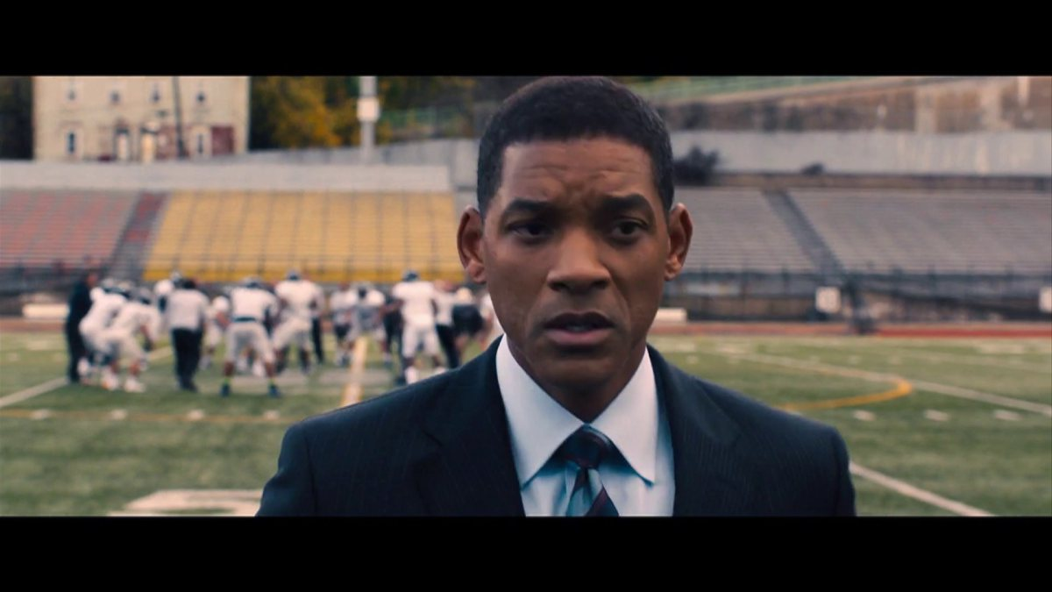
Topic overview
Media & Medical
Biomechanical Analysis
Case Values

Slide 4

Trickle Down Effect
More Awareness:
Attorneys
Medical Professionals
General Public, i.e., plaintiffs
Insurers

Slide 5

Plaintiff’s Bar Seizes Opportunity
http://www.klinespecter.com/news_plevretes_index.html
http://www.youtube.com/watch?v=mmzjAmsJoXs
http://www.youtube.com/watch?v=hVyyQrwKs44

Slide 6
Claims-Centric Perspective
Marriage of Medical and Biomechanical Analysis
Segway from Sports to Common Claims
  Auto
  Premises Liability

Slide 7

Medical Overview

Slide 8
Medical Lingo - Concussions
GCS=Glasgow Coma Scale, PTA=Post Traumatic Amnesia, LOC=Loss of Consciousness
ACRM: LOC<30 minutes, PTA<24 hours, any alteration in mental status at the time of injury, transient or ongoing neurologic symptoms (e.g. headache)
WHO: LOC<30 minutes, PTA <24 hours, confusion and disorientation at the time of injury, transient neurological abnormalities

Slide 9
Pre Injury Factors
Previous Concussions/TBI
Medical Status
Psychiatric Conditions
Learning Problems
AD/HD
Stress

Slide 10
Common Concussion Recovery
17-28% have rapid recovery (1 day)
56-68% have gradual recovery (1-7 days)
10-19% have prolonged recovery (1 week – 1 month)
2-5% have persistent symptoms (>1 month)

Slide 11
Signs and Symptoms
Physical
  Headache, fatigue, dizziness, gait disturbance, light and noise sensitivity, visual disturbance
Sleep
  Difficulty falling asleep and staying asleep
Mood/Behavior
  Impulse control, anger, anxiety, depression, suicidal thoughts, personality
Cognitive
  Concentration, memory, processing speed

Slide 12
Headache
Most common symptom
Can be very disabling
Characterized by a constant pain usually helped by rest
May be worse if history of headache or family history of headache
Medications
  Amitriptyline, Topamax
Lifestyle modifications

Slide 13
Fatigue
Can be a problem for some
Encourage activity in small amts and increase as tolerates
Frequent breaks
Scheduled rest periods
Learned behavior

Slide 14
Dizziness
Difficult to treat
Meclizine
Evaluate for secondary cause such as inner ear trauma
PT/OT

Slide 15
Anxiety/Depression
Early on
  Worry about not working, functioning in typical roles
  Falling behind
Later
  Anxiety disorder
  Depression
  Adjustment
Treatment
  Antidepressants
  Counseling
  Psychiatric treatment

Slide 16
Memory
Verbal
Visual
Amantadine
Aricept
Speech therapy for cognitive training
Work accommodations
  Reduced workload
  Reduced hours

Slide 17
Post concussion syndrome
Is it a true physiological entity or is it mainly a psychological occurrence?
Comparing trauma patients with and without brain injury
There is a behavioral health overlay.
The sick role.

Slide 18
Multiple Concussions
Literature illustrates that multiple concussions possibly cause negative outcomes and long term-deficits

Slide 19

Multiple Concussions
History of prior concussion linked to:
  Decreased cognitive performance on baseline testing
  Prolonged recovery in a mixed high school/college sample
  Greater likelihood of reporting depression
  Greater incidence of MCI
  3-6x as likely to experience another concussion
  Case reports of chronic traumatic encephalopathy (CTE)

Slide 20
Signs of Potential Secondary Gain or Malingering
High degree of lateralization on NP tests.
Failing formal validity measures
Pattern of test scores inconsistent with researched scores for the particular syndrome.
Excessive recovery time for mild injuries
Disability report that is disproportionate to the severity of the injury
Severe memory deficits on NP tests
Poor scores on easy items

Slide 21
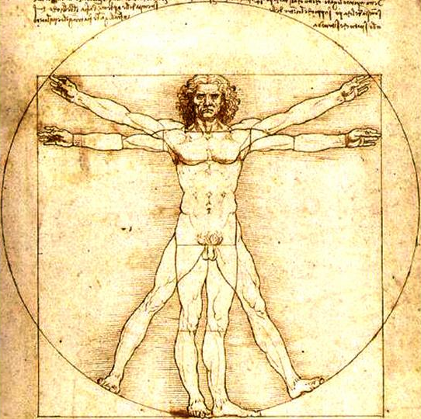
Biomechanics of
Injury Causation

Slide 22
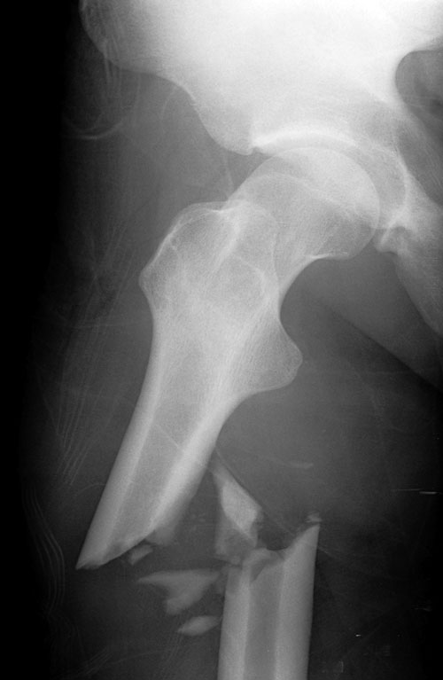
Biomechanics –
Engineering / Material Science of Injury Causation
  Injury = Mechanical System Failure
    Application of engineering principles to analyze mechanical failure
      How much force did it take to fracture the femur?
      What direction of loading caused the fracture?
Every material has a critical value…INJURY THRESHOLD!!

Slide 23
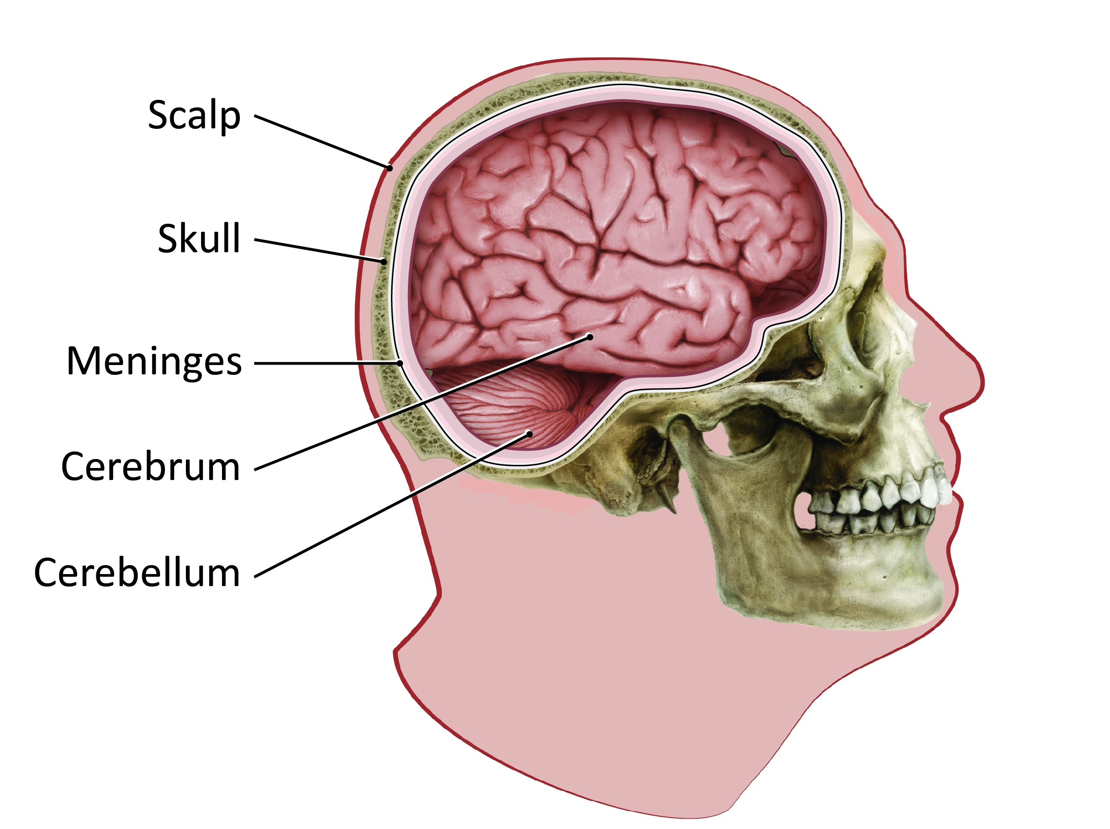
Anatomy of the Head / Brain

Slide 24
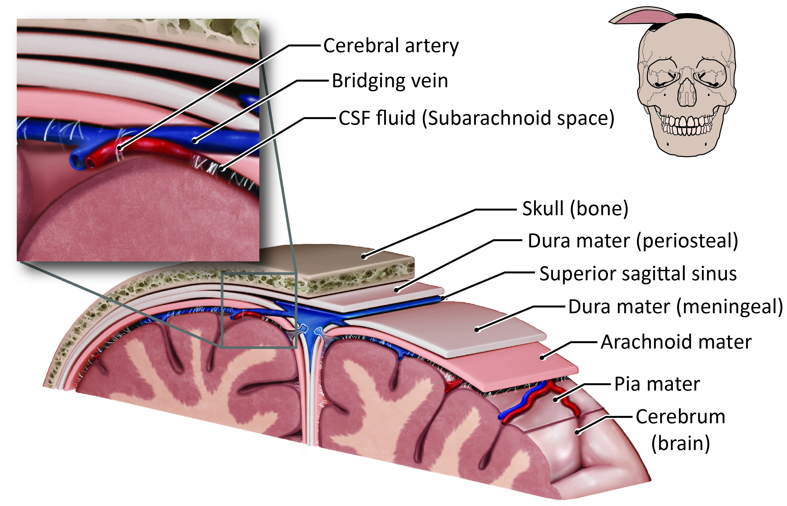
Anatomy of the Head / Brain

Slide 25
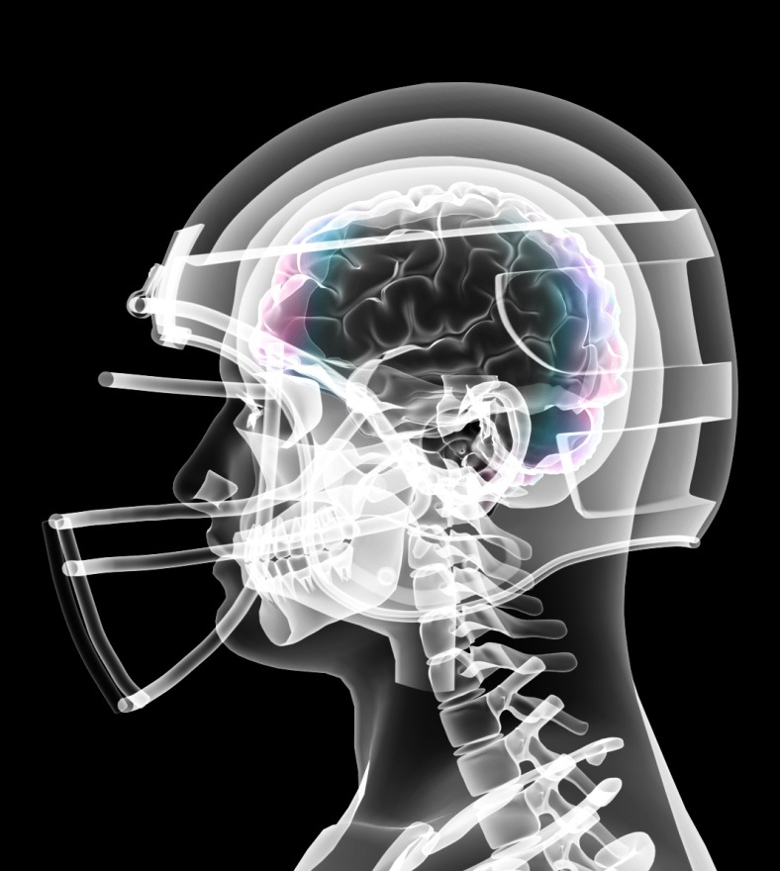
Injuries
Traumatic Brain Injury (TBI)
  Mild, moderate, severe
Concussion
Diffuse Axonal Injury (DAI)
Fracture
Hematoma

Slide 26
Brain Injury Definitions
Traumatic brain injury (TBI)
  Mechanical force causes brain dysfunction
    Mild TBI (MTBI)- temporary dysfunction of brain cells, clear CT / MRI
    Severe TBI- bruising, torn tissues, bleeding & other physical damage
Concussion- type of TBI
  Clinical syndrome characterized by immediate and transient alteration in brain function, including alteration of mental status and level of consciousness, resulting from mechanical force or trauma
  Second Impact Syndrome (SIS) may result from exposure to multiple concussions
  Chronic Traumatic Encephalopathy (CTE) is a degenerative brain disease linked to multiple concussions over a lifetime

Slide 27
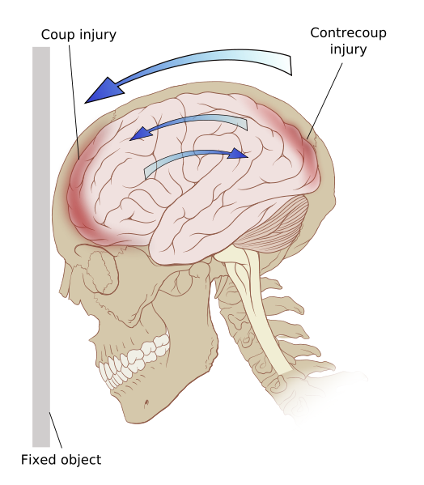
Coup / Contrecoup
Injury Mechanism

Slide 28

Coup / Contrecoup Distribution
83%
7%
10%
79%
14%
7%
50%
10%
40%

Slide 29
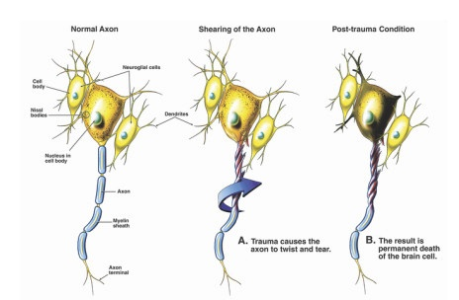
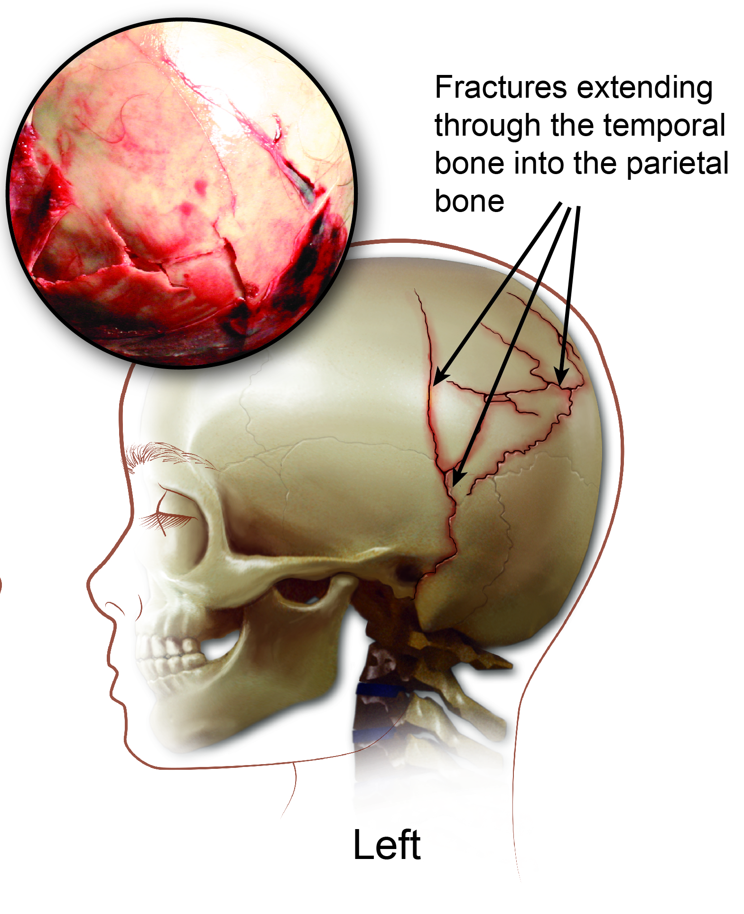
DAI and Skull Fracture
Diffuse axonal injury
  Axons are part of the brain’s white matter
  Rotational trauma causes the axon to twist and tear
Skull fracture
  Any break in the cranial bones
  Closed, open, depressed, comminuted

Slide 30
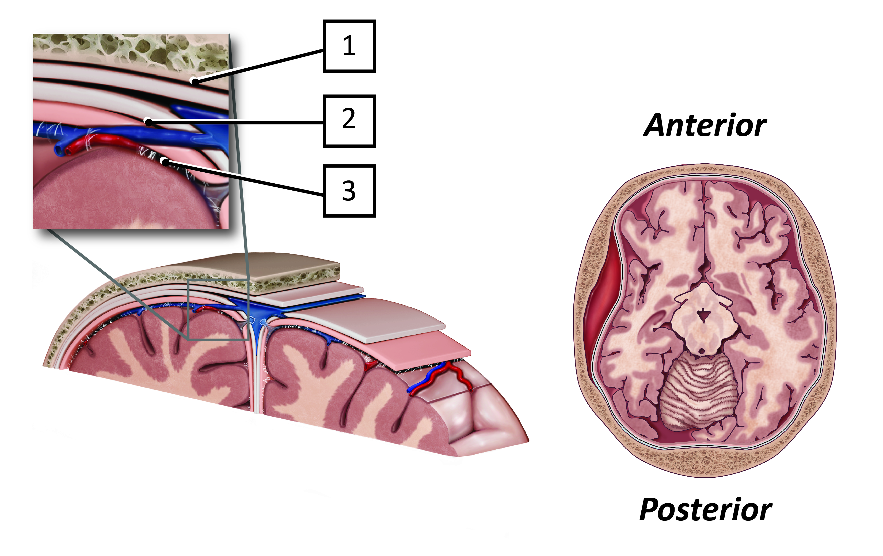
Hematoma
Bleeding “somewhere”
  Epidural – between the dura and skull
  Subdural – between brain and dura
  Subarachnoid – between brain and thin surrounding tissues

Slide 31
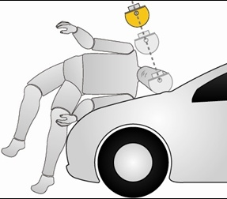
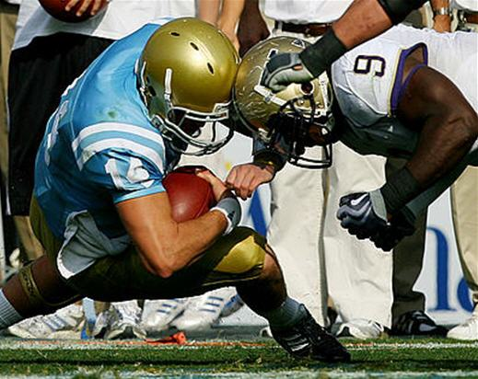
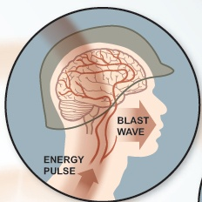
Potentially Traumatic Events
Slip and fall, trip and fall
Vehicle crashes
  Pedestrian, motorcycle, cars, bicycles
Violence
  Gunshot, domestic violence, child abuse
Sports
  Football, baseball, soccer, hockey, boxing
Explosive blast & combat injuries
  Armed Forces, Police, etc.

Slide 32
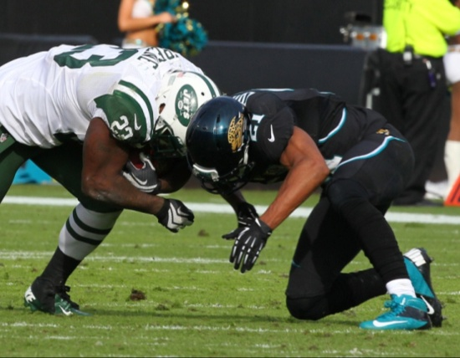
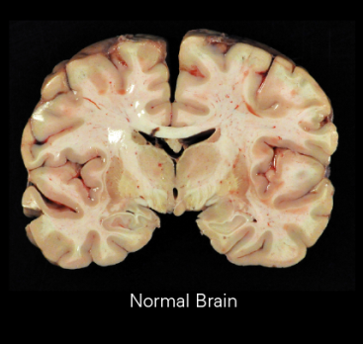
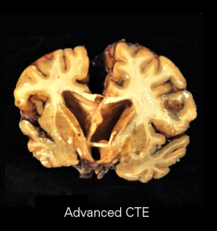
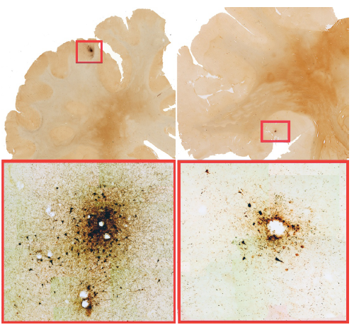
Injury Causation
Single traumatic loading
  Impact
Multiple loading events over a period of time
  Degenerative disease
In order to cause an injury in a single event, both must apply:
  Appropriate injury mechanism
  Sufficient loading beyond the structure’s injury threshold

Slide 33
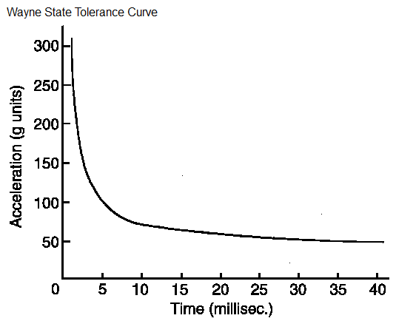
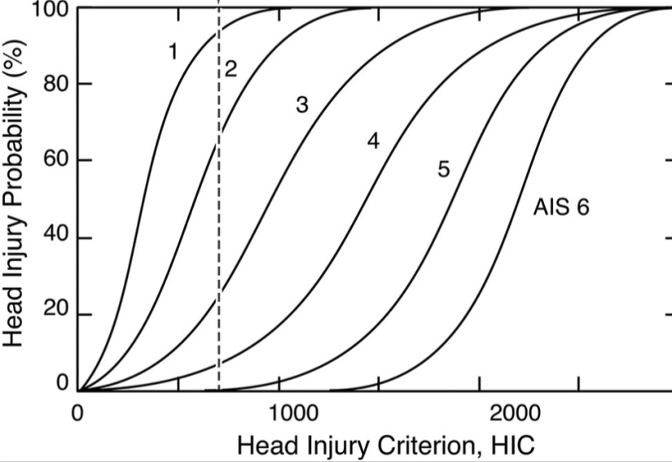


Injury Criteria
Criteria used to evaluate injury potential
Linear / Angular Acceleration Limits
HIC - head injury criterion
  Concussion, mTBI
SIMon- simulated injury monitor
  Cumulative Strain Damage Measure (CSDM) based on theory that diffuse axonal injury is associated with cumulative volume of the brain matter experiencing tensile strains over a critical level
Notes:
SIMon- FE head model – loaded by acceleration time history from crash dummies

Slide 34
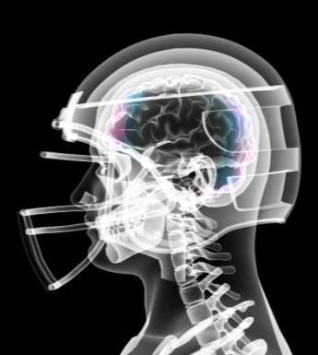
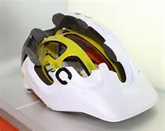
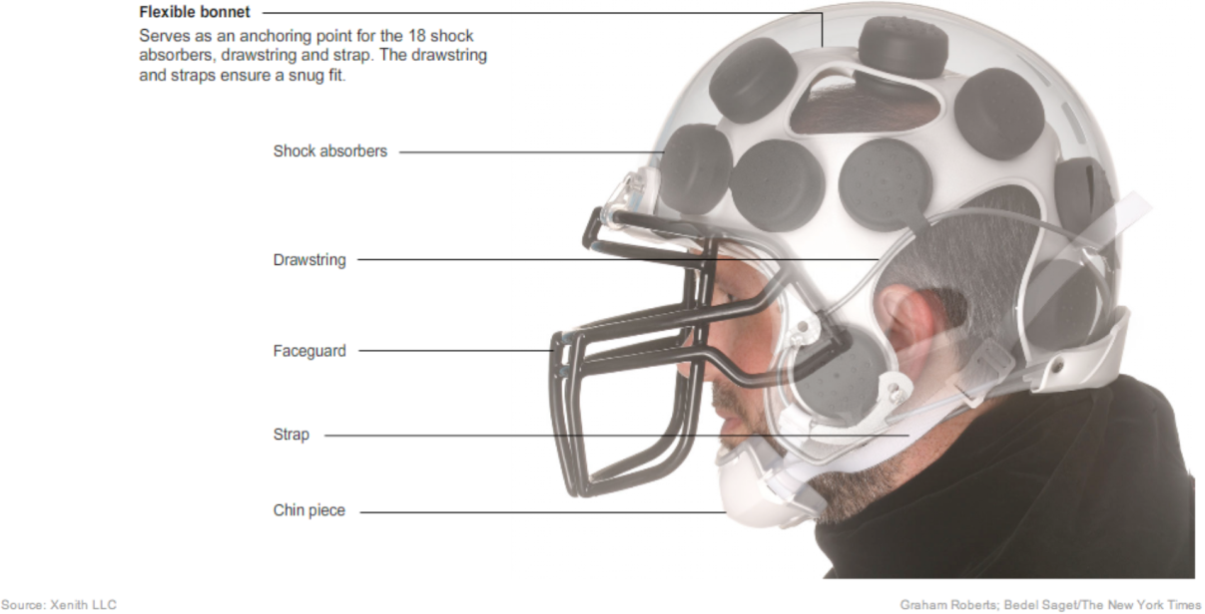
Role of the Helmet
Benefits
  Dampen Peak G
  Spread contact area (reduce pressure)
Concerns
  Increases duration
  Adds mass
  Shear / rotational effects
Notes:
SIMon- FE head model – loaded by acceleration time history from crash dummies

Slide 35
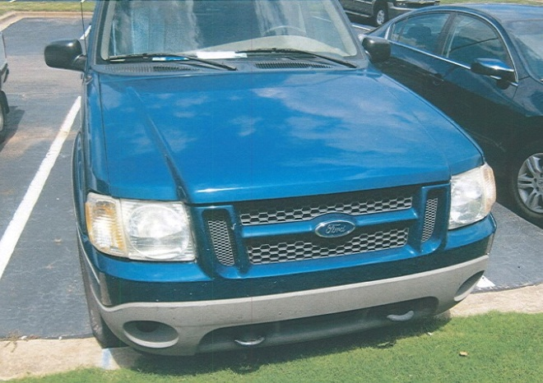
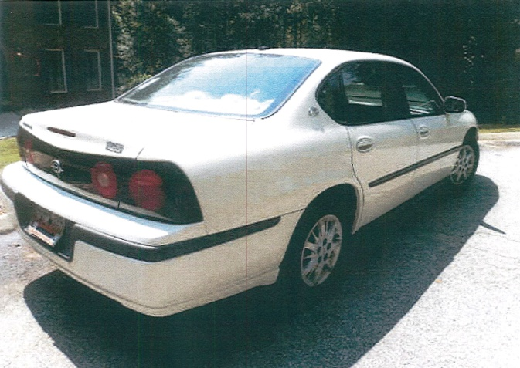
SC Case Example
Spartanburg County, SC - 61YOF, Asserted Post-concussion Syndrome, mTBI (memory loss, sensory changes, depression, sleep disturbances)
Medical History: Clinical depression, anxiety, suicidal, migraines, etc.
Plaintiff Expert: Clinical and Neuropsychologist – concluded mTBI & post-traumatic concussion syndrome based upon neuropsychological and psychological “tests”
Defense Expert: Vehicles: DV < 6mph, < 2-3g, Occupant: Head < 12g, HIC < 11, Rot. Acc < 600rad/s² - No support for injury causation contention
^{Verdict: Defense}

Slide 36
Analysis - Minor Impact Exposure
WSTC- associates linear head acceleration with brain injury potential
Exceeds tolerance level
Below tolerance level
100
10 g peak
90 msec duration

Slide 37
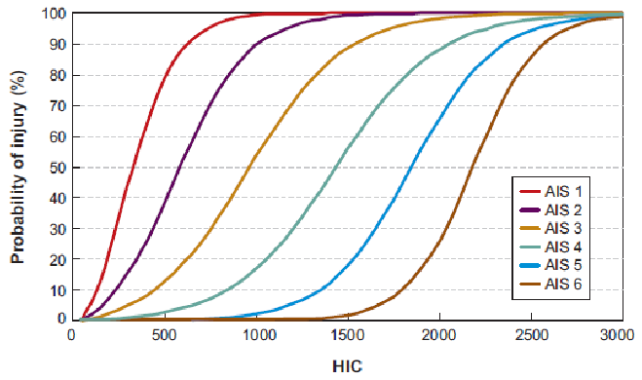
Analysis - Minor Impact Exposure
Typical minor impact exposure
HIC = 5 to 15

Slide 38

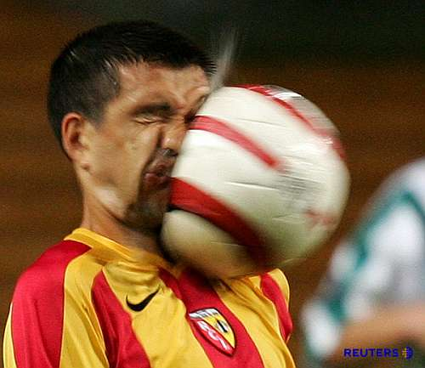
Defenses to TBI Claims
Age –degeneration?
Not single event condition
Prior head trauma
Comparative loading scenarios
  Activities of daily living
Multi(-vehicle) accident
  Did the injury occur from the other accident?
Helmet vs. no helmet
Linear vs. angular acceleration
Malpractice Issues – “Golden Hour”

Slide 39
Three State Survey
PA, MD, NJ
Source: Westlaw database
Time Period: January 31, 2013 through January 31, 2016
Outliers Excluded: Special situations such as brain injury from birth or extreme verdicts encompassing multiple severe injuries are indicated separately and are not part of statistical sample.

Slide 40
Pennsylvania

Slide 41


PA – ANALYSIS OF SETTLEMENTS
PER COUNTY AND STATEWIDE
 | Bucks | Chester | Montgomery | Philadelphia
 | $300,000 | $230,000 | $5,000 | 3 million
 | $60,000 |  |  | 2.8 million
 | $60,000 |  |  | 2.620 million
 |  |  |  | $850,000
 |  |  |  | $500,000
Avg. | $140,000 | N/A |  | 1.954 million
Median | $60,000 | N/A |  | 2.620 million
 | Total amount of settlements | Number of Settlements | Average | Median
 | $10,425,000 | 10 | $1,042,500 | $400,000

Slide 42
PA Verdicts
Trials and arbitrations
Total number of arbitrations/trials: 63 (2 federal)
Total number of jury verdicts: 55
    Plaintiff Jury Verdicts: 32
    Defense Jury Verdicts: 23
Number of Million Dollar Verdicts: 3
    3.0 million – Philadelphia County – construction accident with claims of traumatic closed head injury with post concussion syndrome; other injuries included partial rotator cuff tear, traumatic thyroid bleed, soft tissue injury to neck and back, neuropathy and radiculopathy
    2.5 million - Philadelphia County – construction accident with blow to the head from a cement pump hose causing TBI with concussion with memory loss, headaches, and short temper; other injuries included T-11 compression fracture, aggravation of pre-accident back condition with inability to return to employment
    1.6 million – Allegheny County – MVA –asserted TBI with impaired cognition, expressive aphasia, headaches and loss of job as engineer; other injuries included esophageal rupture requiring surgery, pneumothorax, cervical radiculopathy & PTSD

Slide 43
PA - Chart of Plaintiff Verdicts under 1 million dollars 2013-2015
(state court only)

Slide 45
PA – Wrap up
Excluded from this analysis is the class action lawsuit filed against the NFL in the District Court for the E.D. of Pa which settled on 6/28/2013 for the amount of $765,000,000
Breakdown by Case Type
Analysis of the Verdicts and Arbitrations
  Median of all jury
  verdicts: $52,500
  Average of all jury
  verdicts: $345,792
  Median of arbitration
  verdicts: $9,750
  Average of arbitration
        verdicts: $18,689
  Median of Total: $50,000
  Average of Total: $280,371

Slide 46
MD - Trial & Settlements
NO REPORTED SETTLEMENTS OF ANY KIND
TOTAL NUMBER OF JURY VERDICTS: 57
    Plaintiff Jury Verdicts: 38
    Defense Jury Verdicts: 19
NO JURY VERDICT OVER A MILLION DOLLARS
95% OF TRIALS WERE MVA – both liability and UIM (1)
LARGEST VERDICT - $903,496 - WAS GL CASE - SLIP AND FALL IN

Slide 47
MD – Jury verdicts under $1.0 million
(2013-2015)

Slide 48
MD – Verdicts by county
(2013-2015)
 | A.A | B.C. (8) | Bal Cty. | Calvert | Carroll | Charles | Frederick | Howard | Montgom. | P.G. Cty.
1 | $300,000 | $70,000 | $61,628 | $65,000 | $50,000 | $100,000 | $125,000 | $903,496 | $21,177 | $310,124
2 | $36,208 | $15,865 | $32,500 |  | $18,326 |  | $95,945 | $150,000 | $18,010 | $ 59,758
3 | $32,951 | $13,100 | $15,000 |  |  |  |  | $ 35,000 | $10,000 | $ 45,000
4 |  | $ 1,452 | $ 6,946 |  |  |  |  |  | $ 8,359 | $ 40,046
5 |  | $ 1,394 | $ 1,377 |  |  |  |  |  | $ 7,770 | $ 31,468
6 |  |  |  |  |  |  |  |  |  | $ 21,510
7 |  |  |  |  |  |  |  |  |  | $ 16,066
8 |  |  |  |  |  |  |  |  |  | $ 15,750
9 |  |  |  |  |  |  |  |  |  | $ 7,513
10 |  |  |  |  |  |  |  |  |  | $ 5,290
11 |  |  |  |  |  |  |  |  |  | $ 3,701
Total | $369,159 | $224,864 | $117,451 | $65,000 | $68,326 | $100,000 | $220,945 | $1,088,496 | $65,315 | $556,226
# | 3 | 5 | 5 | 1 | 2 | 1 | 2 | 3 | 5 | 11
Median | $36,208 | $13,100 | $15,000 | n/a | $34,163 | n/a | $110,473 | $ 150,000 | $10,000 | $ 21,510
Average | $123,053 | $44,973 | $23,490 | n/a | $34,163 | n/a | $110,473 | $ 362,832 | $13,063 | $ 50,566

Slide 49

MD – Wrap up
Analysis of the Verdicts
Median Total: $ 26,489
Average Total: $ 72,448
Median w/o high verdict: $ 21,510
Average w/o high verdict: $ 49,857
Breakdown by Case Type

Slide 50
NEW JERSEY

Slide 51
NJ – ANALYSIS OF SETTLEMENTS
PER COUNTY AND STATEWIDE
 | Bergen | Mercer | Middlesex | Union
 | $285,000 | $4.1 million | $750,000 | $80,000
 |  |  |  | $1.975 million
Avg. | N/A | N/A | N/A | $1,027,500
Median | N/A | N/A | N/A | $1,027,500
 | Total amount of settlements | Number of Settlements | Average | Median
 | $7,190,000 | 5 | $1,438,000 | $750,000

Slide 52
NJ Verdicts – trials
Total number of jury verdicts: 15
    Plaintiff Jury Verdicts: 8
    Defense Jury Verdicts: 7
    Number of Million Dollar Verdicts included in sample: 2
    3.261 million – Cumberland County – GL – 57 y/o woman - slip and fall on rice spilled in store and not cleared for an hour – asserted post-concussion syndrome with claims of neuro-psychological deficits including impaired memory and processing speed and headaches; other injuries included herniations at multiple lumbar levels requiring a stimulator, rotator cuff tear requiring two surgeries and depressive disorder due to inability to work.

Slide 53
NJ - Jury verdicts under a million
(2013-2015)

Slide 54
NJ – Wrap up
SIGNIFICANT VERDICTS – NOT INCLUDED
17 MILLION DOLLARS - ESSEX COUNTY, NJ – MVA
Female, age 42 - bag caught in the door of New Jersey Transit bus causing her to be dragged 25 feet and subsequently run over by the bus; injuries included a crushed pelvis, crushed elbow, fractures, internal bleeding and brain damage; physical and brain injuries limited her ability to testify at trial; defendant had denied all liability
BIRTH INJURY CASES
*failure to timely diagnose placental insufficiency leading to cognitive deficits – 9.6 million
*failure to timely perform C-section leading to meconium aspiration and hypoxia – 9.6 million
SIGNIFICANT SETTLEMENT – NOT INCLUDED
SAD BUT TRUE
5-month old savagely beaten by father resulting in brain damage, blindness and spastic quadriplegia - recovery against 2 hospitals – the 1st for failing to recognize “shaken baby syndrome” and holding child for 72-hr observation so DYFS could investigate, child was returned to parents; the 2nd for failing to report a significant mouth tear injury to DYFS and to review past records which would have noted suspected abuse – Total settlement of medical providers 7.475 million
Analysis of the Verdicts
Median Total: $ 725,000
Average Total: $ 1,360,125
Breakdown by Case Type

Slide 55
The end
Comments or Questions?
Thank You!

