Slide 1
THE SHARING Economy CPCU Reinsurance Interest Group Symposium March 10, 2016 Philadelphia, PA
Gerry Finley, Sr. Vice President,
Underwriting Services, Munich Re America
+1- 609-243-4527
gfinley@munichreamerica.com

Slide 2
Sharing Economy Agenda
Introduction – What It Is
Impact on Employment
Home Sharing
Transportation Sharing
Takeaways/Wrap Up
Legal and Insurance – General Considerations

Slide 3
Sharing Economy
What It Is

Slide 4
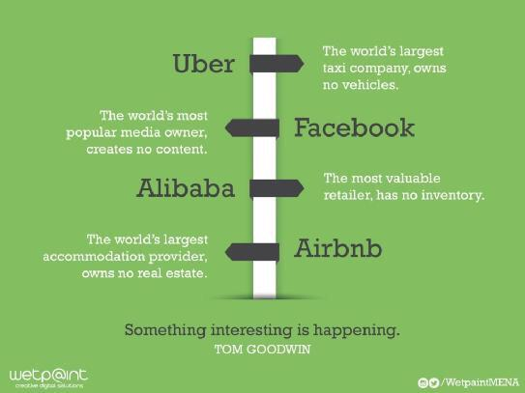
The Sharing Economy ………..What It Is
The New World Order of Business
The “Sharing Economy” * May Transform the US Economy, it’s Workforce…………and the P/C Insurance Industry
* Also known as: On Demand or Peer to Peer”
Not “Sharing”…For Profit
……But
No Property
No Equipment
No Inventory
No Sales Staff

Slide 5
The Sharing Economy ……….What It Is
The Business Model….Peer to Peer; On Demand; Sharing
Seller
(On Demand, Freelance Provider)
Buyer
(On Demand User)
Technology Platform
Technology Network Company (TNC)
Alternate Forms of:
Generation Shift in Thinking
Property use
Property Ownership

Slide 6
The Sharing Economy ……….What It Is
Millennial Trends … an example
20-24 Year Olds Driver License Ownership dropped from 92% in 1983 to 77% in 2014
University of Michigan Transportation Institute, 2016
16 Year Olds
20-24 Year Olds

Slide 7
The Sharing Economy …………What It Is
US Adult Population Perspective of the Sharing Economy
44% familiar; 56% Not familiar
19% have engaged in a sharing economy transaction
Who is most excited
18-24 year olds
Household with incomes between $50K and $75K
Those with children in the house <18 years of age
Sellers/Providers – 7%: Broad Spectrum
Price Waterhouse Coopers Consumer Intelligence Series 2016 Report (pwc.com/CISsharing)

Slide 8
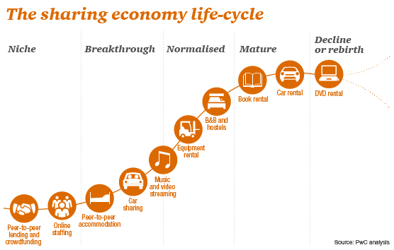
The Sharing Economy …………What It Is
The “S” Curve
Peer to Peer “Sharing” v. Company to Customer Renting
Sharing
Traditional Rental
“Sharing” as a % of the Total Rental Market:
2013…..6% $15b of $240b)
2025….. 50% ($335b of $670b)
http://www.pwc.co.uk/issues/megatrends/collisions/sharingeconomy/the-sharing-economy-sizing-the-revenue-opportunity.html

Slide 9
The Sharing Economy …………What It Is
The Forerunners of Today’s Peer to Peer
Started 1989: On-line grocery delivery service
Started 1995: e-Commerce consumer to consumer sales
Started 1995: Classified Advertisement web-site…housing; jobs; items for sale or wanted, etc.
Started 1995: Contractors and other service providers
Started 2000: Dating web-site
Pre-cursor to Airbnb?????

Slide 10
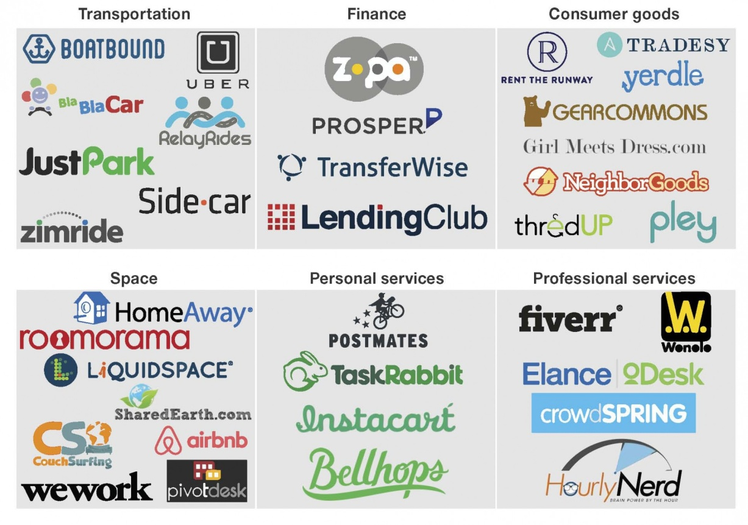
The Sharing Economy …………What It Is…Anything and Everything
From e-Bay to………..?????
$
“Sharing”
“Profit”
Price Waterhouse Cooper, 2015 Report:
Total Global Value of Sharing Economy transactions
2014 ~ $15 billion estimated
2025 ~ $335 billion annually
http://www.pwc.co.uk/issues/megatrends/collisions/sharingeconomy/the-sharing-economy-sizing-the-revenue-opportunity.html
US Dominates:
50% Global Sharing Cos. (led by SF)
SF, NY, Boston. LA = Same number of Sharing Cos. as all of Europe
Just Park Study as reported in CrowdFund Insider 10/1/15
Source: Forrester Research, Inc. 2015

Slide 11
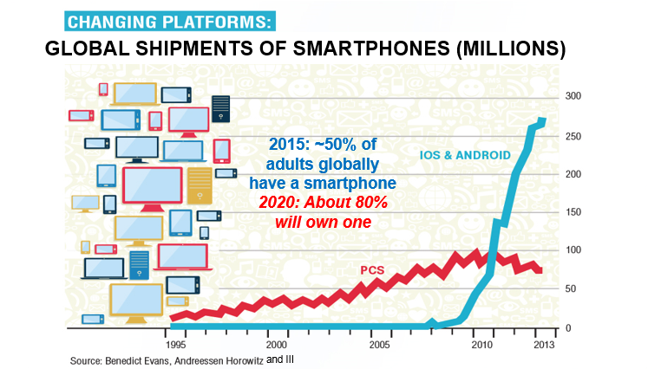
The Sharing Economy …………What It Is
Smartphones: Breakthrough technology behind the on-demand economy

Slide 12
The Sharing Economy ….What It Is
…… A Simpler Life at your Fingertip…
Get married
…Move
…Do Laundry
Someone to do your “tasks”
…..Get something done around the house
…or Get Legal Advise …

Slide 13
The Sharing Economy …….What It is
The Big 3
Have Car …Will Travel
Have Space…Will Rent

Slide 14
Sharing Economy
Impact on Employment

Slide 15
Employment …..Labor on Demand
How will jobs be impacted?

Slide 16
Temporary Workers vs. All Nonfarm Employment, 2010-2015*
Employment …..Labor on Demand
Annual Percent Change
Demand for temporary workers has increased 2 to 3 times faster than for workers overall in recent years
All
Temp
*Through September 2015.
Source: US Bureau of Labor Statistics , Insurance Information Institute.

Slide 17
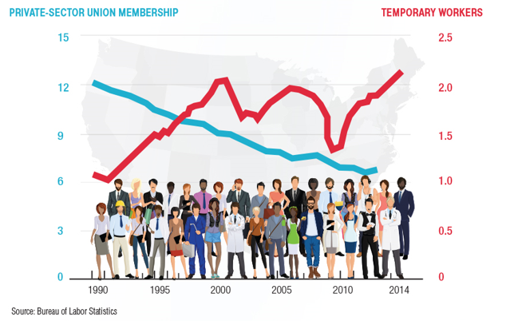
Employment …..Labor on Demand
Union v Temp % of Workforce …a 25 Year View

Slide 18
Employment …..Labor on Demand…. Two Schools of Thought…
Glass Half Full
Technology frees workers from the bonds of centralized, hierarchical institutions (the firm)
Enhanced coordination of “haves” with “needs” that bypass firms as intermediaries
Segments that Benefit
“Flexers”: People who value or require flexibility in work arrangements (stay-at-home parents, retirees, students, disabled)
Professionals: People with portable skills that can be offered through online platforms (semi and high-skilled trades, professional services)
Unemployed/Underemployed: Offers at least some opportunity to offer and utilize skills and generate income
Sources: Wall Street Journal; The Economist; Insurance Information Institute research.
18
12/01/09 - 9pm
eSlide – P6466 – The Financial Crisis and the Future of the P/C
Notes:
18

Slide 19
Employment …..Labor on Demand…. Two Schools of Thought…
Glass Half Empty
On-Demand companies: software-driven marketplaces; “platforms” rather than “employers”
Jobs reduced to freelanced, temporary “gigs”
Low skill workers and those who lack flexibility are left further behind
Workers treated as independent contractors without basic worker rights
Stability, Retirement Benefits, Sick Pay, Overtime Maternity Leave
Health Insurance, Liability Coverage, WC Coverage
Enormous valuations: extraction of resources that otherwise would go to benefits, investments in safety, training, etc.
Sources: Wall Street Journal; The Economist; Fortune; Insurance Information Institute research.
19
12/01/09 - 9pm
eSlide – P6466 – The Financial Crisis and the Future of the P/C
Notes:
19

Slide 20
Sharing Economy
Legal and Insurance:
General Considerations

Slide 21
Sharing Economy
……….Business Model Litigation
Employees or Independent Contractors?
Several TNCs facing Class Actions
HomeJoy (House Cleaning) – Shut Down, in part due to worker Class Action
Try Caviar; Gub Hub; Door Dash (Restaurant Delivery Service)
Washio - (Laundry/Dry Cleaning)
Instacart (Grocery Delivery)
Postmates (Delivery Service)
Uber (Ride Sharing)
Lyft (Ride Sharing)
All are Worker Provided Services …
……Unlike Home Sharing (Airbnb) or Car Sharing (Relay Rides) Services
It Only Takes One Influential Court Decision in the employees favor…….
………………to destroy the basic Sharing Business Model…

Slide 22
Sharing Economy
……….Business Model
Federal Legislation
US Congress and FTC
…….Looking at developing Federal Laws / Regulations for the Sharing Economy
Aim….
…….Prevent unfair trade practices, discrimination, anti-competitive or deceptive behavior of Sharing platforms or participants
State Legislation is rapidly developing… ……aimed at specific Services (e.g., Ride Sharing)

Slide 23
Employment …..Labor on Demand….
For Service Oriented On Demand Businesses
Employees or Independent Contractors
Employee:
Control
Expense Reimbursement
WC Benefits
Social Security Insurance
Paid Vacation, Sick Leave
Etc, etc,
Independent Contractor:
Formal Contract/Agreement
Choose when to work subject to the contract
No explicit Expense Reimbursement
Etc, etc.
Possible Solutions
Hybrid Employment ????????
For Vehicle Related Services …..Autonomous Vehicles - But would they have to Own the Cars ??
23
12/01/09 - 9pm
eSlide – P6466 – The Financial Crisis and the Future of the P/C
Notes:
23

Slide 24
Sharing Economy …….Insurance Impact
Many Segments of the Economy and many Lines of Insurance will be Impacted
Auto (personal and commercial)
Homeowners/Renters
General Liability Coverages
Professional Liability
Workers Comp
Many insurance Issues……..and Opportunities!!!!!!
………Carriers are increasingly
developing to fill the insurance
needs/gaps
24
12/01/09 - 9pm
eSlide – P6466 – The Financial Crisis and the Future of the P/C
Notes:
24

Slide 25
Sharing Economy …….Insurance Impact
Some General Points
On-Demand Platforms Generally Resist Assuming Liability or Responsibility Unless Compelled to Do So
Companies Have Sought to Push as Much Liability as Possible to the Person Offering their (Contracted) Labor or Resources
Minding the Gap
Traditional insurance will often not cover a worker engaged in offering labor or resources through these platforms
E.g., Auto ins. generally won’t cover you while driving for Uber
Home ins. won’t cover for other than occasional rentals of property
Unless self-procured, on-demand worker (independent contactors) will generally have no workers comp recourse if injured on the job
Long Legislative and Court Battles Lie Ahead, Including Determination of Who is an Employee vs. Independent Contractor
25
12/01/09 - 9pm
eSlide – P6466 – The Financial Crisis and the Future of the P/C
Notes:
25

Slide 26
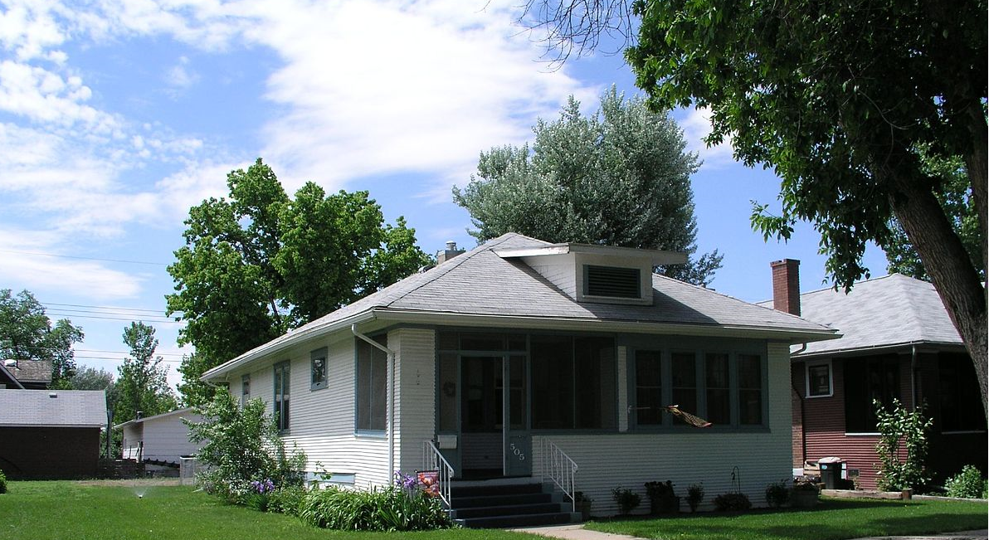
Sharing Economy
Home Sharing
Wikimedea.com Creative Commons Attribution 2.0 Generic license

Slide 27
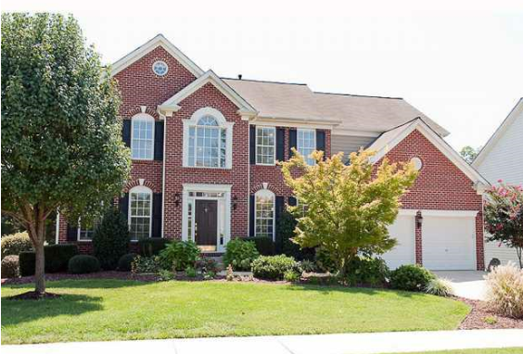
Home Sharing …..What it is
Arrangement where host temporarily “shares” space with travelers……For a fee
Homeowners and apartment dwellers
supplement income
Operations in 34,000 cities worldwide
Potential challenge to hotel industry

Slide 28
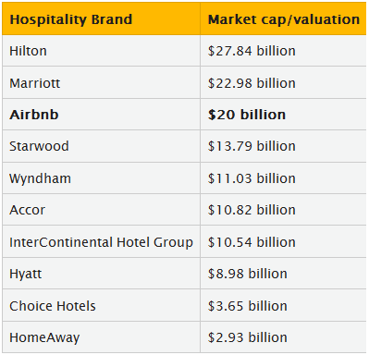
Home Sharing ……Some Numbers
Airbnb: The Clear Leader
Privately owned – Founded 2008
At least: 1mm listing; 25mm Guests;
34K Cities in 190 Countries
Market Cap - $20b (3rd behind Hilton, and Marriott)
Revenues:
Booking Fees (6-12% of Rental)
Host Service Fee (3% for credit card Processing)
Estimated Annual Revenue @2015 = $500m
Competitors:
2nd: Homeaway (acquired VRBO) Market cap $2.93b
FlipKey (Trip Advisor)
Many others
Source: http://skift.com/2015/02/28/airbnbs-new-1-billion-funding-would-value-it-at-20-billion/
https://www.airbnb.com/about/about-us

Slide 29
Home Sharing ……Exposures/Loss Scenarios
Damage to the Host Home (incl. Business Interruption) or Personal Property..
Or Guest personal Property
Injury to the Renter resulting from the Host Home…as “Invited Guest”
3rd Party
Cyber
1st party
“Platform Risk” for all parties – TNC, Host, Renter
Image: Insurance Information Institute

Slide 30
Insurance Coverage …….Where is the Coverage?
Typical HO Policy
Mixed; Coverage varies by carrier both as to if….. and how
An Example: ISO HO3
“Business Use” Excluded (Section II, Coverage E Liability)…has an exception for “rental” under certain conditions, e.g.,
Rental on an “occasional” basis (2B-1a)
“Business” is defined (Def. #3) in part as including…“part-time or occasional”… activities except volunteer or home day care activities if any insured receives $2,000 or more in total compensation for the 12 months before the beginning of the policy period;
The Issues: 1] What is “occasional”; 2] Income Limit
Personal Property Not Covered:
4f - Property of roomers, boarders, other tenants unless related to the insured
4g - Property in an apartment regularly rented to others other than $2,500 as “Landlord” property
What to Do?
Business Policy—specifically either a hotel or a Bed and Breakfast policy
Home-sharing Policy – Month-to-month basis. Exclusions and limitations are Key

Slide 31
ISO Homeowners Policy …..Proposed Changes
Policy Holder Notice to contact Insurer for Coverage Clarification
Guidance
Specific Exclusion applicable to Host and Landlord
All Loss or Damage arising out of Homesharing excluded
Will work toward crafting Language that preserves existing Coverage for renters (e.g., roomers or boarders) that don’t constitute “Homesharing” (definition will be key)
Exclusion
Applicable for Host and Landlord
Property/Liability Coverage for Loss Arising out of Homesharing
Optional Coverage
Net Effect: Insureds must Advise Carrier if they are engaged in Homesharing

Slide 32
Insurance Coverage …….Where is the Coverage?
Special Home Sharing Coverage Available by SOME Home Sharing Platforms
Some examples (Specific Coverage needs to be understood – e.g., exclusions):
Airbnb Host Guarantee Coverage - Will reimburse homeowner for up to $1,000,000 in damage to the hosts eligible property
Airbnb Host Protection Insurance – Up to $1mm CGL Coverage for the host for injury to guests in a listing or elsewhere on the building property during a stay and, where applicable, their landlords or HOAs
Peers.org- Homesharing Liability Insurance - $1m Liability Insurance limit that follows homeowner wherever they list their home
Homeaway- Property Damage Protection – Guest Coverage to protect renter from paying out of pocket for accidental damages to the host property
New Product Opportunity???

Slide 33
Home Sharing ……Legal Issues
Airbnb Friendly Laws: Encourage growth and economic benefit
Restrictive Laws: Police Illegal Activities and raise Tax Revenues
Laws vary significantly by municipality but two restrictive examples:
Santa Monica requires the Host to:
Remain in the residence during visitor stay;
Obtain a license;
Remit 14% transit occupancy tax;
Take responsibility to actively prevent nuisance activities.
New York:
Multiple Dwelling Law - Prohibits buildings occupied by 3 or more families to be rented for less than 30 days
Single or Two Family Residences require a Certificate of Occupancy expressly permitting short term rentals.
Most Laws Regulate Hosts/Home Providers
(not the Sharing Platform itself)
Home Sharing Platforms require Host to be aware of the Law…..
…..But some movement (CA SB 593) by states to require the Home Sharing Platform rather than the Host to know local laws and inform the Host

Slide 34
Home Sharing ……Legal Issues
Discrimination
(Source: Racial Discrimination in the Sharing Economy: Evidence from a Field Experiment, Harvard Business Review January 6, 2016)
Study by Harvard Business School:
Finding: Discriminatory Practices Observed
Field Experiment on Airbnb
Guest Applicants with African-American names were 16% less likely to be accepted that identical Guest Applicants with distinctively White names.
Didn’t matter whether the host was African American, White, Male or Female or whether the host property was expensive or moderately priced.
Those who reject an African American Guest find a replacement only 35% of the time
Legal Implications:
On-Line Marketplaces are legally protected ….so not likely to be found liable for allowing discrimination
Hosts more likely to be held Liable (Civil Rights Act of 1964) depending on size

Slide 35
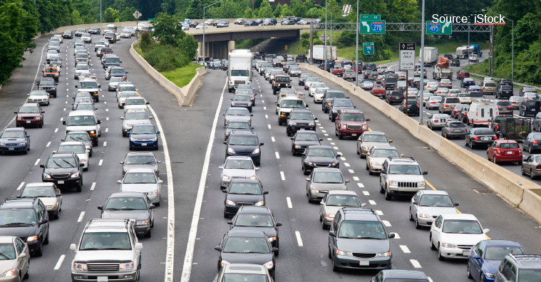
Sharing Economy
Transportation Sharing

Slide 36
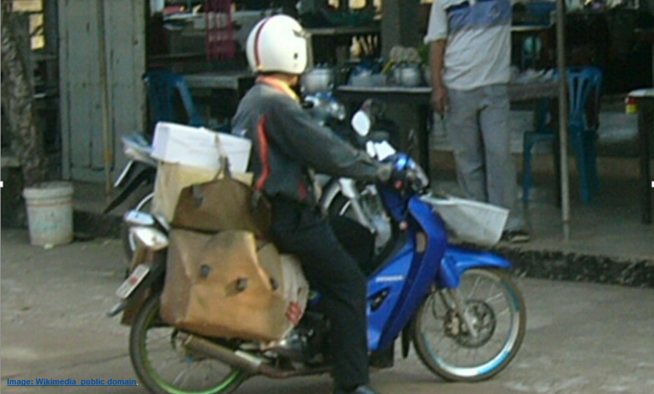
Transpiration Sharing
……. What It is
Boat Rentals
(BoatBound)
Parking Space Rentals (JustPark)
On Demand Delivery (Delivery Hero; Grub Hub, etc)
Ride Sharing
Zimride – Focus College Campuses using social networks – Facebook; typically longer term rides
BlaBla Car - Customized Ride Sharing (Person to Person; typically longer rides )
UBER, LYFT, etc – On demand = Taxi Like
Car Sharing
Turo, Classic Car Share, etc = Car Rental Like

Slide 37
Ride Sharing
……. What It Is
Ride-sharing arrangements are made through….. Technology Network Companies (TNCs)
TNCs provide platform, software and infrastructure that connects drivers and passengers in real time
Most Prominent in the US: UBER and LYFT
UBER
2007
Market cap $40b
55 Countries
275 Cities (58% in the US)
LYFT
2012
75 US Cities
Fuzzy Pink Mustache

Slide 38
Ride Sharing
……. What It Is
Not Just for Millennials
Source: TIME 8/3/15

Slide 39
Ride Sharing
……. What It Is
Traditional Companies….. Hitching a Ride
GM: 2015/2016 Announced:
$500m investment in LYFT by acquiring the assets of Sidecar Technologies (a defunct ridesharing company)
MAVEN – Created to consolidate its Car Sharing Programs (city based car sharing); competes with ZIPCAR ; App will allow use of a Chevy for $6.00 an hour
Developing an enhanced Chevy Bolt (2017) – Electric Car that includes Ride Sharing Electronics.
Ford: 2016 Announced:
FORD CREDIT LINK – “Closed” Car Sharing (“ZIPCAR for Friends”)
Groups of 3-6 people agree to jointly lease (not buy) an Ford vehicle
An APP is used to arrange make car and insurance payments, arrange maintenance, and schedule who uses the car, when and how long

Slide 40
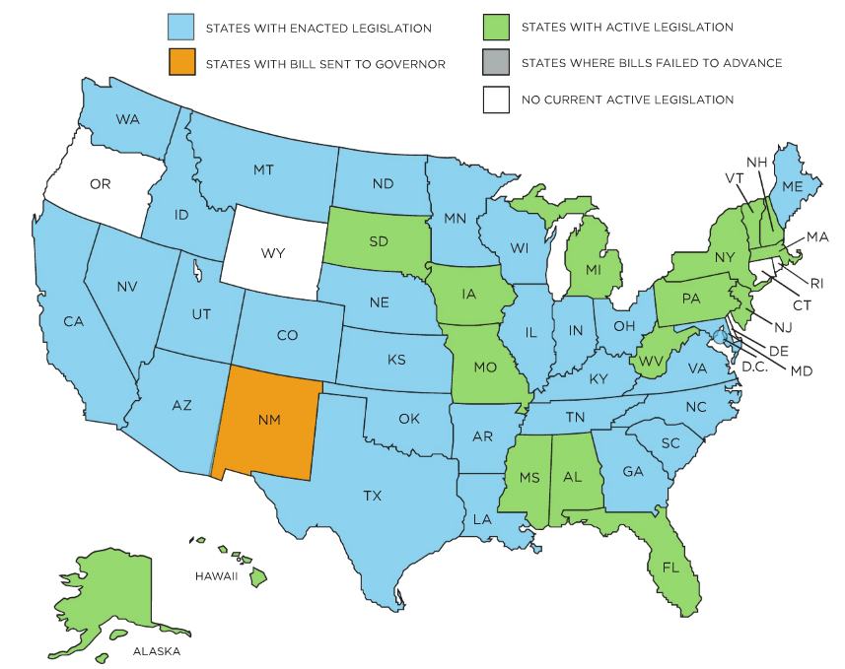
TNC / Ridesharing ……..State Regulation/Legislation
Status @ March 2016
State Specific Laws Vary: e.g., insurance requirements; special licensing or certificate requirements; driver background checks; limit where drivers can operate; etc.
Source: PCI

Slide 41
Ride Sharing
……Exposure
Types of TNC Exposure
Phase 1 | Driver logged in but not “matched” with a passenger yet
Phase 2 | Driver / Passenger “Match” made…but passenger not picked up yet
Phase 3 | Passenger is in the vehicle
Coverage Issues: WC and Liability Exposure Varies by Status
Increasing Number of States are Considering or Have Passed Regulations for TNCs

Slide 42
Ride Sharing
……Coverage Issues
In addition to Typical Accident Based Issues (e.g., Fault)
Auto
Integrity of Standard Auto Policy Livery Exclusion
What, if any, Coverage is granted to the Car Owner?
When does TNC Coverage Apply?
Are there any restrictions?
Whose Coverage is Primary : Car Owner or TNC?
Is Coverage consistent with State Ridesharing (TNC) Law?
Are the Drivers Employees or Independent Contractors?
Are TNCs just Technology Platforms or Employers
Does it vary based on when in the process the Drivers are injured?
Does it matter how many hours the Driver is connected?
Does it matter if the Driver has another Full Time Job
Workers
Compensation

Slide 43
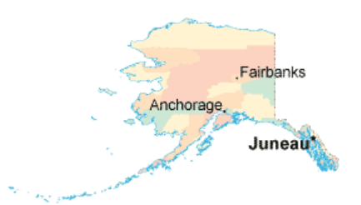
Ride Sharing
…..Legal Issues
Some Legal Issues of Note……Possible Precursor to Insurance Claims
CA Fines UBER $7.6M: Potential Discrimination
Failing to report information to the state (as required by law) on driver safety, and access for people with disabilities and how it was serving neighborhoods by Zip code (monitoring discriminatory practices)
UBER Fined $20K: Data Breach
Delayed Data Breach Notification
UBER Leaves Alaska
Paid $78K to WC Guarantee Fund after the state decaled UBER Drivers are Employees
http://alaska-map.org/

Slide 44
Ride Sharing
…..WC Legal Issues
Some Legal Issues of Note……Possible Precursor to Insurance Claims
UBER CA Driver Class Action (Driver Status)
Drivers Sue Uber contending they are employees not independent contractors – entitled to reimbursement of expenses (e.g., gas and vehicle maintenance)…but would also possibly lead to a requirement to pay social security taxes, provide WC, etc.
Pending…Could result in Fundamental Change to the “Sharing” Business Model …
San Francisco Federal Judge allowed and expanded Class Action to proceed. Trial set for Summer, 2016
CA Legal Presumption: Workers are Employees unless proven otherwise:
(7/15 Dept of Labor issued an interpretive memo indicating that the DOL feels most workers classified as Ind. Contractors are really employees under the Fair Labor Standards Act broad definitions)
Some tests Courts will use/include Degree of Control over how the work is done; Who supplies tools/equipment, etc
Lyft – Settled employment class action (subject to court approval):
$12.25m;
Will amend terms of contract with drivers to be consistent with the definition of a “Contractor” – drivers can’t be fired at will (only for cause);
Deactivation and Pay issues subject to arbitration
…impact on Uber case unknown.

Slide 45
Ride Sharing
….. Automobile Issues
Commercial Insurance Not Required
Drivers Rely on Personal Auto
Gaps in Coverage Exist
Most States Starting to Act…
TNC / Ride Sharing laws – Stipulating Required Coverage for TNC Drivers;
Consumer Alerts – As to Potential gaps

Slide 46
Ride Sharing
……Auto Insurance Legislation Focus
Insurance Industry: TNC Model Legislation Essential Elements
Support for Innovation – Provide clear guidance for both the transportation and insurance market place
2) Protecting Insurance Product Certainty:
Protect the enforceability of private passenger automobile “livery” or “for hire” exclusions
Preserve the ability of auto insurers to take rating and underwriting action as respects TNC activity in private passenger automobile policies.
Reinforce that personal auto lines policies do not provide coverage for TNC activity unless the policy expressly provides for that coverage.
3) Define TNC Activity and TNC Insurance Requirements:
Define TNC activity to encompass Phase 1, 2 and 3.
Require that TNCs and/or TNC drivers carry primary coverage that specifically covers TNC activity as defined.
4) Provide Clarity and Avoid Dispute:
Require the insurer that specifically covers TNC activity to defend in the event of a dispute about whether the driver was engaged in TNC activities as defined,.
The TNC shall share data / information in timely fashion to facilitate resolution of the dispute.
Keys:
Personal Auto Integrity – TNC Activity Not Covered unless specifically endorsed to do so
Require TNC Specific Coverage as Primary Coverage

Slide 47
Market Response…
….Automobile
TNC Coverage
(Still Evolving)
Phase 1 - Some TNCs:
Provide contingent liability coverage at a nominal limit
If personal auto coverage is declined/not available
Phases 2 and 3 - Some TNCs:
Provide liability and UM/UIM coverage (primary for personal auto, excess for commercial auto) at a higher limit than Phase 1;
Also may provide contingent comprehensive/collision coverage based on certain specified circumstances
TNC Insurance Framework: - Phase 1 Limits = $50/100/25; - Phase 2 and 3 = $1m

Slide 48
ISO Response
…..Commercial Auto
Current ISO Commercial Auto Program
Does not explicitly address ride-sharing risks; Not Excluded; New Coverage Option?
Business Auto Policy
No general eligibility restrictions that would preclude coverage for either the TNC or drivers for their respective ride-sharing exposure.
However….. ISO Addressing In Commercial Auto and Umbrella:
Developing Optional Exclusions:
Driver Ride Sharing Activities
Ride Sharing and On Demand Delivery
Updating
Rules
Loss Costs
Possibly classifications
Specific to Ride Sharing and On Demand

Slide 49
ISO Response
…..Personal Auto
Advisory Notice to Policyholders
9/14 Advisory Notice to Policyholders (PP P 011 09 14) and Circulars (LI-PA-2015-080 and 124): Regarding Ride-Sharing (highlights the "public or livery conveyance" exclusion)
Reinforced Public or Livery Conveyance Exclusion (PP23 40)
Filing an endorsement to reinforce the "public or livery conveyance“ Exclusion;
Reinforces the public or livery conveyance exclusion: - including any period of time while an insured is
logged into a TNC application…
…..Phases 1 through 3 excluded
Exclusions
We do not provide Liability Coverage for and “insured”:
For that “insured’s” liability arising out of the ownership or operation of a vehicle while it is being used as a public or livery conveyance. This includes but is not limited to any period of time the vehicle is being used by any “insured” who is logged into a “transportation network platform” as a driver. Whether or not a passenger is occupying the vehicle.
Personal Umbrella has a similar Exclusion (DL 99 12)

Slide 50
ISO Response
…..Personal Auto
To Fill the Gaps (Circulars (LI-PA-2015-080 and 124):
2 optional endorsements filed (PA only, not PU) which would provide:
An option to purchase coverage with respect to Phase 1 only (Logged In/No Match)
An option to purchase coverage with respect to both Phases 1 (Logged In/No Match) and Phase 2 (Logged In and Matched but Not Yet Picked Up) …….Endorsements PP23 41 and PP23 45 respectively
Rules/Rating – Specific to Ride Sharing Activities
Territory: Majority of TNC Activity
Mileage: Attributable to TNC Activity
Use: TNC Capacity Specific
Future Plans:
Considering creating a Self-contained Policy to address all phases of participation as a TNC driver.
Several Carries are actively providing / considering providing Hybrid Coverage

Slide 51
Personal Auto/TNC ……Insurance
Ride Sharing Coverage Application
Phases | TNC Provided Coverage | ISO Public/Livery Exclusion | ISO New Personal Coverage Options
1 Driver Logged in; “No Match” | Contingent Liability Coverage ($50/100/25)* – IF PA coverage declined or not available | Excluded | Coverage Available
2 “Match” made; Not Picked Up | Primary Liability/UM/UIM ($1mm Limit)* Contingent Comp/Collision may apply
3 Passenger Picked Up |  |  | No Coverage Available
(*According to publicly available information, as of 6/2/2015)
Several TNCs and Carriers are actively providing or considering providing Coverage ………
…………….Some for all 3 Phases

Slide 52
Personal Auto/TNC ……….Insurance
App Off
App On
Match Found
Passenger Picked Up
Passenger Dropped Off
Drivers
Personal Auto Policy
TNC Provides
Primary Liability/UM/UIM ($1m Limit)
Contingent Comp/Collision (up to $50k)
App Off
App On
TNC Provides Contingent Coverage ($50/100/25) – IF PA coverage declined / not available

Slide 53
Sharing Economy
Takeaways / Wrap-up

Slide 54
Sharing Economy
Takeaways/Wrap Ups
Risk / Opportunities Abound
Insurance Industry is Centrally Involved
Peer Economy Is Growing Rapidly
Understand the Risks;
Develop Solutions
Traditional Risks … will be Different
Both Up and Out More of it….. In More Diverse Ways Peer Sharing

Slide 55
Ride Sharing & Home Sharing In Conclusion…..Some General Thoughts
Exposure is Here…….New Exposures for Existing Customers
Need to Address Proactively
Advise Policyholders if/how coverage applies
Inquire as to Insured involvement…..Nature and Extent
Reinforce current policy exclusions if needed
Develop specific Coverage alternatives if intending to cover
Develop Pricing Parameters
Develop Underwriting Guidelines

Slide 56
THE SHARING Economy Thank You For Your Attention
Questions?
© Copyright 2016 Munich Reinsurance America, Inc. All rights reserved. "Munich Re" and the Munich Re logo are internationally protected registered trademarks. The material in this presentation is provided for your information only, and is not permitted to be further distributed without the express written permission of Munich Reinsurance America, Inc. or Munich Re. This material is not intended to be legal, underwriting, financial, or any other type of professional advice. Examples given are for illustrative purposes only. Each reader should consult an attorney and other appropriate advisors to determine the applicability of any particular contract language to the reader's specific circumstances.

